Slide 1
Fibonacci
Modify your main method to time how long it takes to run your Fibonacci method.
How long does it take to find…
  fibonacci(10) ?
  fibonacci(20) ?
  fibonacci(30) ?
  fibonacci(40) ?
  fibonacci(45) ?

Slide 2
Fibonacci – Alternative Data
Add a static integer field to your class called numberOfIterations
Before calling fibonacci, initialize the field to 0. Inside of fibonacci, increment the field. After fibonacci finished, print the field out.
At the top of your source file, make a small data table.
Using this field, determine:
  How many times does the recursive fibonacci method run for the following inputs?
  Test inputs: 1, 2, 3, 4, 5, 6, 7, 8, 9, 10

Slide 3
Fibonacci 2.0
Take a few minutes to write a second Fibonacci method into your FunLoops class. However, write this method without the use of recursion. Instead, use loops to compute the Fibonacci value.
Test this method thoroughly to be sure that it works.
Now, gather both timing data from the looping version of the method with n = 10, 20, 30, 40, and 45 and numberOfIterations data with n = 1, 2, 3, 4, 5, 6, 7, 8, 9, and 10

Slide 4
Fibonacci 2.0 – Data Analysis
You should have times and number of iterations for n from 10 to 45
Take a look at this data. Then, in your comment, write a short paragraph (3-4 sentences for each bullet below):
  What patterns do you see in the timing data? Why is there so much variation in timing data?
  What patterns do you see in the number of iterations data? Because number of iterations is deterministic, it might even be possible to write an equation that has n as an input and iterations as an output.
  Which method is faster? Why?

Slide 5
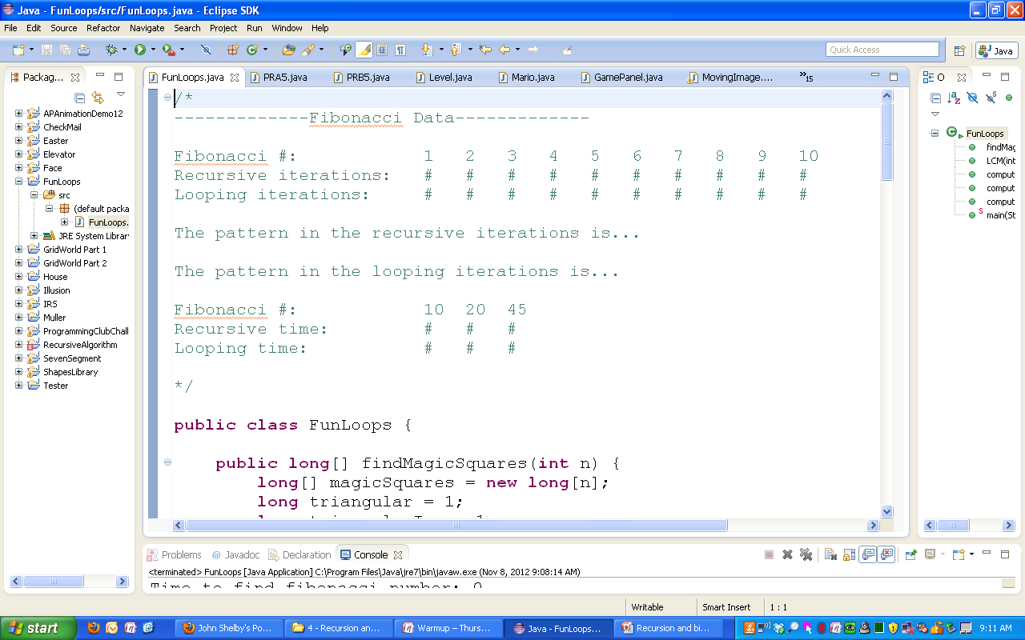

An Example:

